Slide 1
Inverse Reinforcement Learning

Slide 2
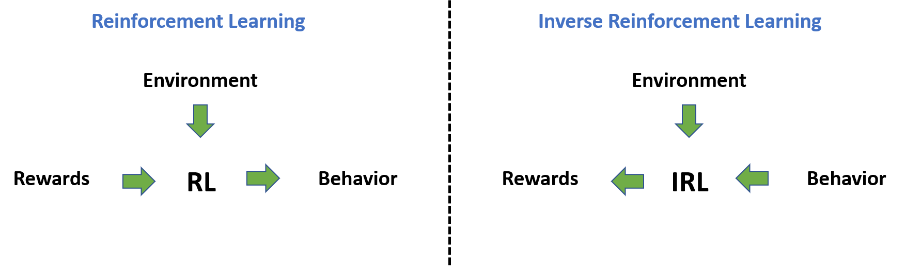
Introduction
No need to manually design reward function to define a task [1]
Learn the reward function from observing an expert, and then use reinforcement learning to re-optimize the reward function [1]
Image Credit [2]

Slide 3
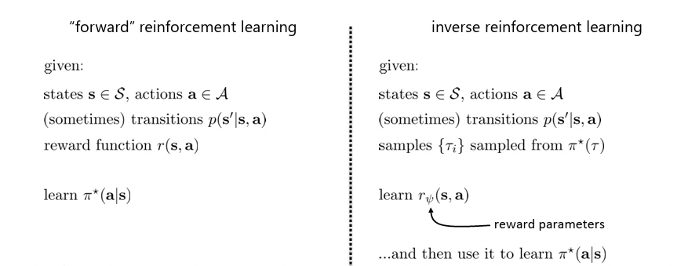
Notes:
Pi* is optimal policy, Tau is the trajectories from the optimal policy

Slide 4
Why?
Standard imitation learning: (Behavior Cloning)
- Copy the actions performed by the expert (joint movements)
- no reasoning about outcomes of actions
Human imitation learning: (Inverse RL)
- copy the intent of the expert
- might take different actions

Slide 5
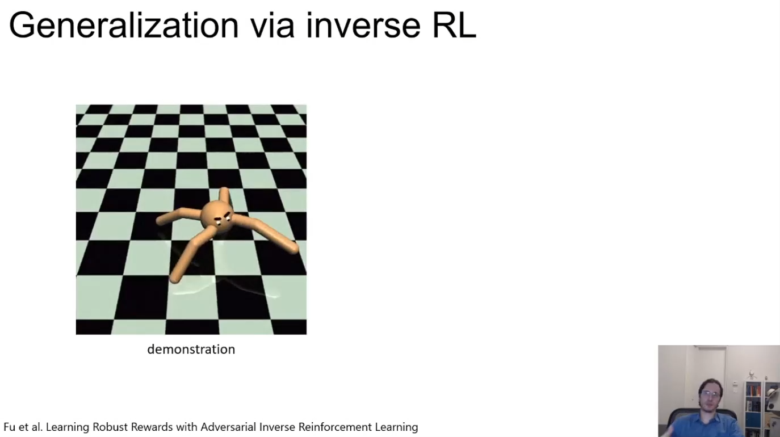

Slide 6
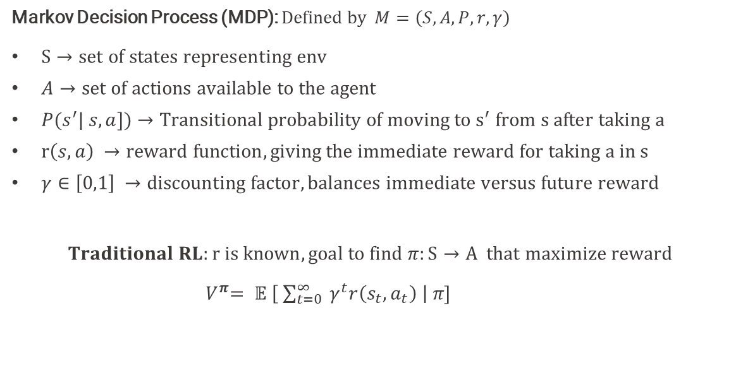
Background RL
Markov Decision Process (MDP): $Defined by M=\left(S, A, P, r,γ\right)$
$S→set of states representing env$
$A→set of actions available to the agent$
$P{(s}^{′}| s,a])$ $→Transitional probability of moving to s^{′} from s after taking a$
$r\left(s,a\right) →reward function, giving the immediate reward for taking a in s$
$γ∈\left[0,1\right] →discounting factor, balances immediate versus future reward$
$$Traditional RL:r is known, goal to find π:S→A that maximize reward$$
${ V}^{π}= 𝔼 \left[ \sum_{t=0}^{∞ }{{ γ}^{t}r\left(s_{t}, a_{t}\right)} \right| π]$

Slide 7
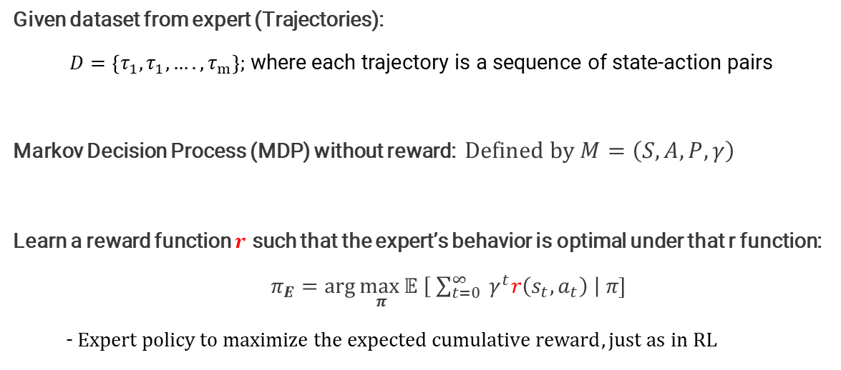
IRL Formulation (High level: More mathematically how to solve)
Given dataset from expert (Trajectories):
$D=\left\{τ_{1},τ_{1}, ….,τ_{m}\right\}\text{; }\text{where} \text{each} \text{trajectory} \text{is} \text{a} \text{sequence} \text{of} \text{state}\text{−}\text{action} \text{pairs}$
Markov Decision Process (MDP) without reward: $Defined by M=\left(S, A, P,γ\right)$
Learn a reward function $r$ such that the expert’s behavior is optimal under that r function:
$π_{E}=\arg{\max_{ π}⁡}𝔼 \left[ \sum_{t=0}^{∞ }{{ γ}^{t}r\left(s_{t}, a_{t}\right)} \right| π]$
- $Expert policy to maximize the expected cumulative reward, just as in RL$

Slide 8
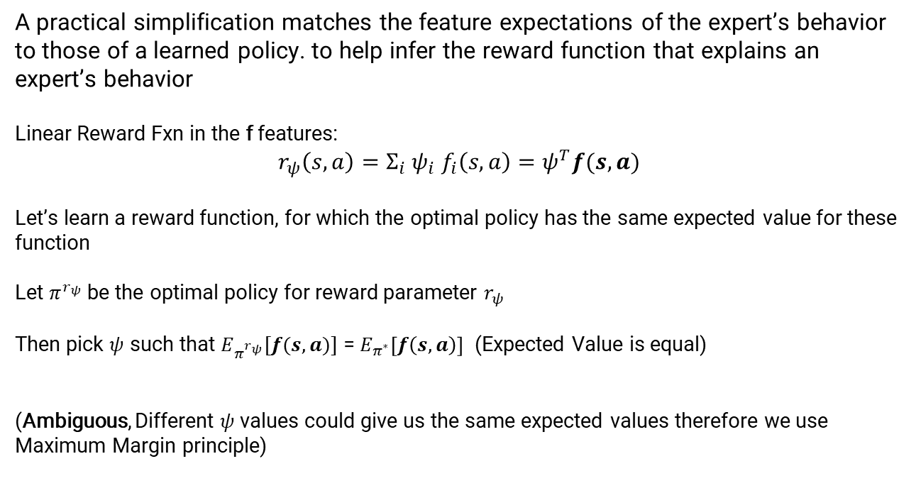
Feature Matching
A practical simplification matches the feature expectations of the expert’s behavior to those of a learned policy. to help infer the reward function that explains an expert’s behavior
Linear Reward Fxn in the f features:
$$r_{ψ}\left(s,a\right)=Σ_{i}{ ψ}_{i}{ f}_{i}\left(s,a\right)=ψ^{T}f(s,a)$$
Let’s learn a reward function, for which the optimal policy has the same expected value for these function
Let $π^{r_{ψ}}$ be the optimal policy for reward parameter $r_{ψ}$
Then pick $ψ$ such that $E_{π^{r_{ψ}}}[f(s,a)]$ = $E_{π^{∗}}\left[f\left(s,a\right)\right]$ (Expected Value is equal)
(Ambiguous, Different $ψ$ values could give us the same expected values therefore we use Maximum Margin principle)

Slide 9
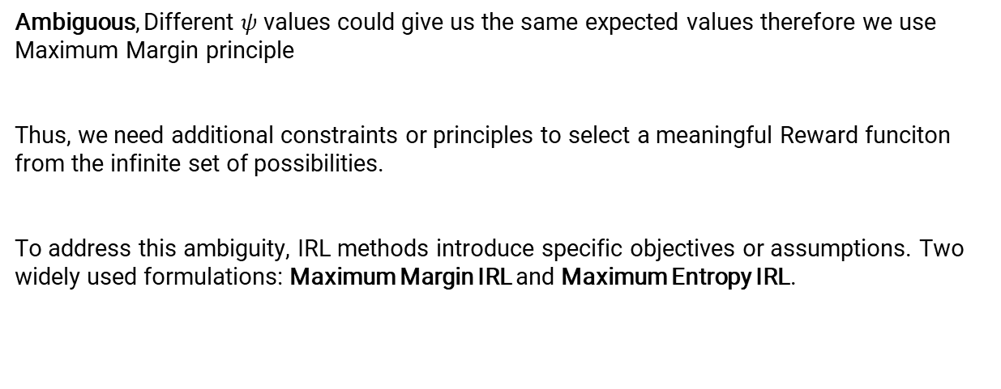
The Challenge
Ambiguous, Different $ψ$ values could give us the same expected values therefore we use Maximum Margin principle
Thus, we need additional constraints or principles to select a meaningful Reward funciton from the infinite set of possibilities.
To address this ambiguity, IRL methods introduce specific objectives or assumptions. Two widely used formulations: Maximum Margin IRL and Maximum Entropy IRL.

Slide 10
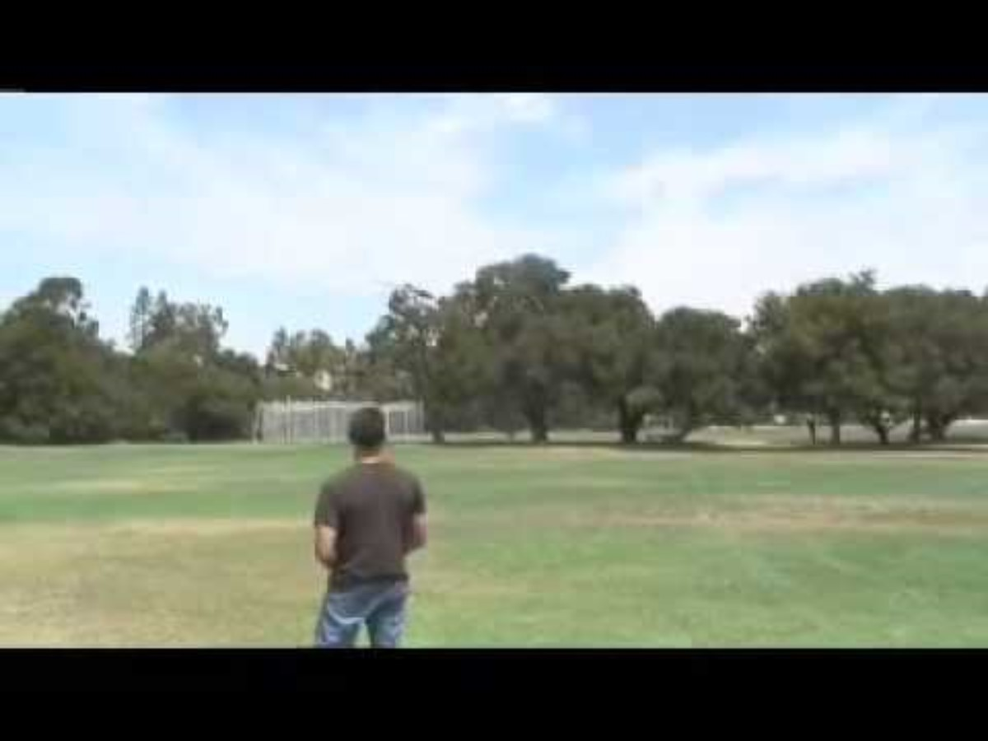
Maximum Margin IRL (Apprenticeship Learning)

Slide 11
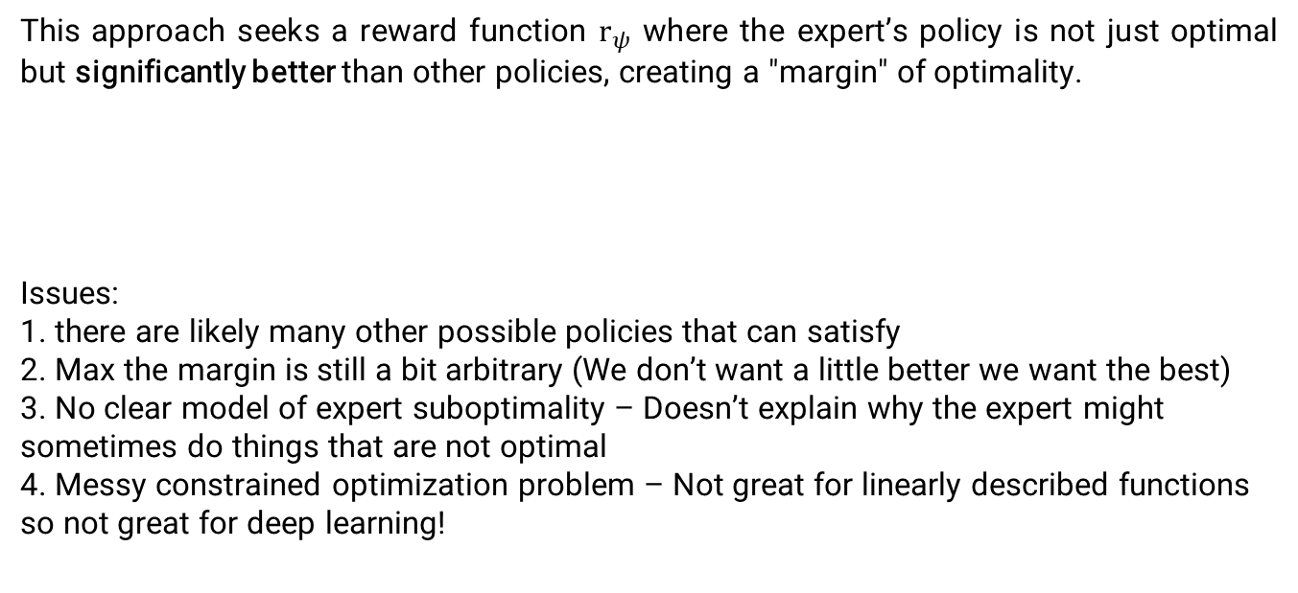
Maximum Margin IRL (Apprenticeship Learning)
This approach seeks a reward function $r_{ψ}$ where the expert’s policy is not just optimal but significantly better than other policies, creating a "margin" of optimality.
Issues:
1. there are likely many other possible policies that can satisfy
2. Max the margin is still a bit arbitrary (We don’t want a little better we want the best)
3. No clear model of expert suboptimality – Doesn’t explain why the expert might sometimes do things that are not optimal
4. Messy constrained optimization problem – Not great for linearly described functions so not great for deep learning!

Slide 12
Maximum Entropy IRL
Principle: The probability distribution which best represents the current state of knowledge is the one with the largest entropy
Simply: The distribution with largest entropy (uncertainty) makes the least assumptions about the true distribution
Notes:
Reward Parameter

Slide 13
Maximum Entropy IRL
This approach models the expert’s behavior probabilistically, assuming that the expert chooses trajectories with probabilities proportional to their total reward.

Slide 14
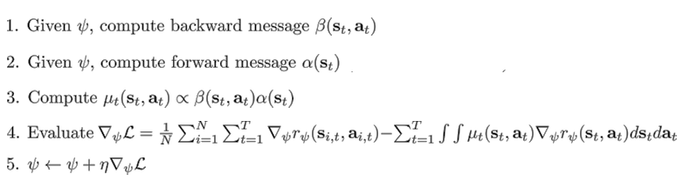
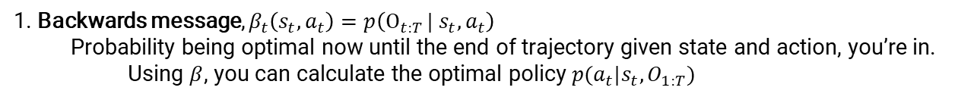
Maximum Entropy IRL
This approach models the expert’s behavior probabilistically, assuming that the expert chooses trajectories with probabilities proportional to their total reward.
1. Backwards message, $β_{t}\left(s_{t}, a_{t}\right)=p\left(Ο_{t:T }| s_{t}, a_{t}\right)$
Probability being optimal now until the end of trajectory given state and action, you’re in.
Using $β$, you can calculate the optimal policy $p(a_{t}|s_{t}, O_{1:T})$
Notes:
Reward Parameter

Slide 15
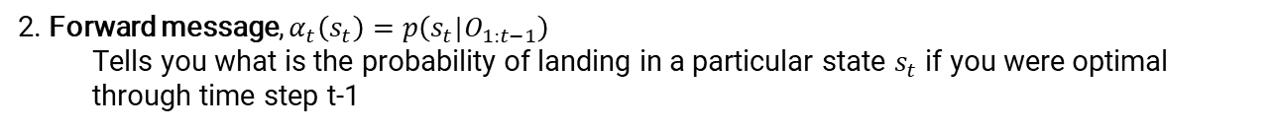
Maximum Entropy IRL
This approach models the expert’s behavior probabilistically, assuming that the expert chooses trajectories with probabilities proportional to their total reward.
2. Forward message, $α_{t}\left(s_{t}\right)=p\left(s_{t}|O_{1:t−1}\right)$
Tells you what is the probability of landing in a particular state $s_{t}$ if you were optimal through time step t-1

Slide 16
Maximum Entropy IRL
This approach models the expert’s behavior probabilistically, assuming that the expert chooses trajectories with probabilities proportional to their total reward.
3. Soft Occupancy: This gives you the expected state-action occupancy

Slide 17
Maximum Entropy IRL
This approach models the expert’s behavior probabilistically, assuming that the expert chooses trajectories with probabilities proportional to their total reward.
4. Gradient of the likelihood of the trajectories as the difference between the average of all the trajectories of $∇_{ψ}r_{ψ}$ and the expected gradient of the reward under the current policy’s distribution

Slide 18
Maximum Entropy IRL
This approach models the expert’s behavior probabilistically, assuming that the expert chooses trajectories with probabilities proportional to their total reward.
5. Gradient decent step on $ψ$ since we’ve just calculated the gradient of the likelihood

Slide 19
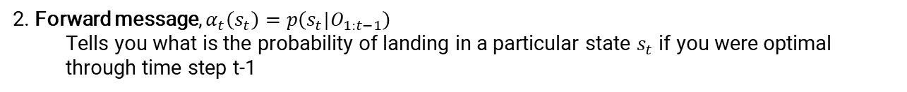
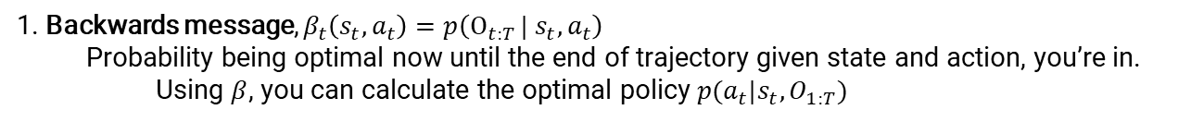
Maximum Entropy IRL
This approach models the expert’s behavior probabilistically, assuming that the expert chooses trajectories with probabilities proportional to their total reward.
1. Backwards message, $β_{t}\left(s_{t}, a_{t}\right)=p\left(Ο_{t:T }| s_{t}, a_{t}\right)$
Probability being optimal now until the end of trajectory given state and action, you’re in.
Using $β$, you can calculate the optimal policy $p(a_{t}|s_{t}, O_{1:T})$
2. Forward message, $α_{t}\left(s_{t}\right)=p\left(s_{t}|O_{1:t−1}\right)$
Tells you what is the probability of landing in a particular state $s_{t}$ if you were optimal through time step t-1
3. Soft Occupancy: This gives you the expected state-action occupancy
4. Gradient of the likelihood of the trajectories as the difference between the average of all the trajectories of $∇_{ψ}r_{ψ}$ and the expected gradient of the reward under the current policy’s distribution
5. Gradient decent step on $ψ$ since we’ve just calculated the gradient of the likelihood

Slide 20
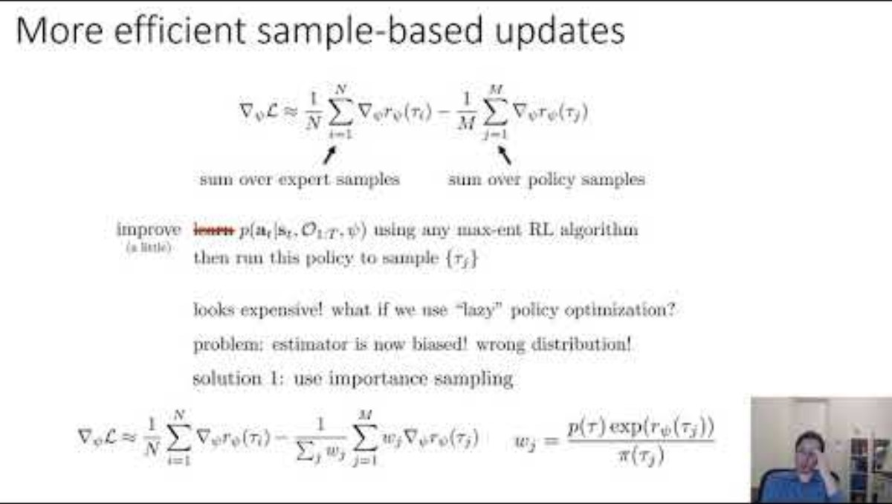
To Apply this in large and continuous state and action spaces

Slide 21
References
CS 285: Lecture 20, Inverse Reinforcement Learning, UC Berkeley EECS, Inverse Reinforcement Learning, https://people.eecs.berkeley.edu/~pabbeel/cs287-fa12/slides/inverseRL.pdf
https://rail.eecs.berkeley.edu/deeprlcourse/deeprlcourse/static/slides/lec-20.pdf
16-831 Intro to Robot Learning, https://drive.google.com/file/d/1_Mm96iscd10zhN4eK4fbnGqzHZpceV1h/view
Inverse RL, 2020, S Vaidyanath https://skandavaidyanath.github.io/post/inverse-rl-paper/
MaximumEntropy Inverse Reinforcement Learning, CMU Paper https://www.cs.cmu.edu/~bziebart/publications/maximum-entropy-inverse-reinforcement-learning.pdf
End-to-end Driving via Conditional Imitation Learning https://arxiv.org/pdf/1710.02410
Knowledge Base IRL https://github.com/apexrl/Imitation-Learning-Paper-Lists?tab=readme-ov-file#inverse-rl

